Slide 1
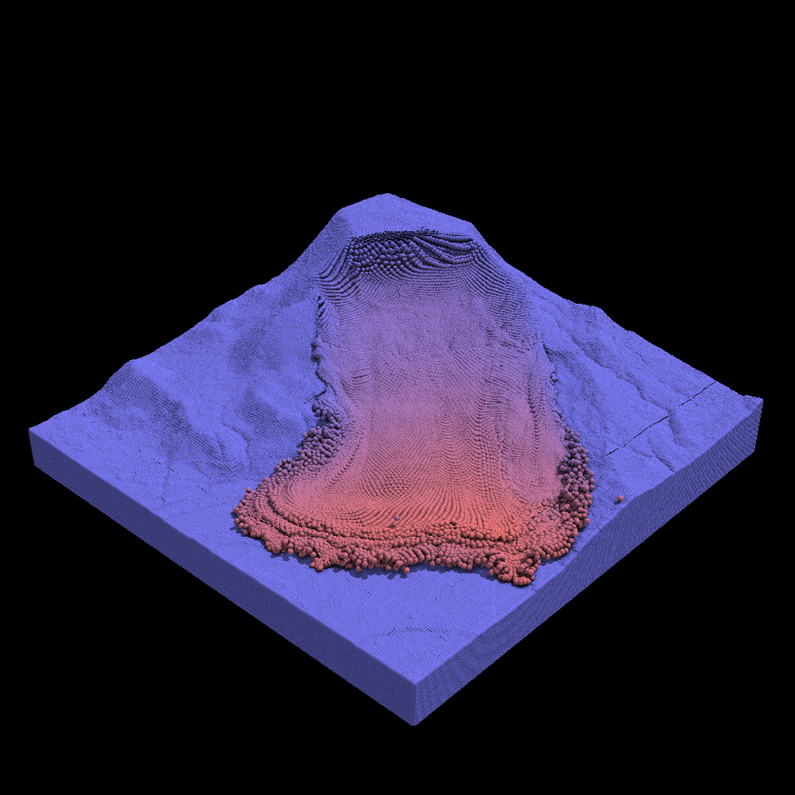
Graph Network Simulator and DiffMPM for inverse problems
Krishna Kumar, The University of Texas at Austin
MPM 2023 Spring Workshop, INRAE Site d'Aix-Le Tholonet, France

Slide 2
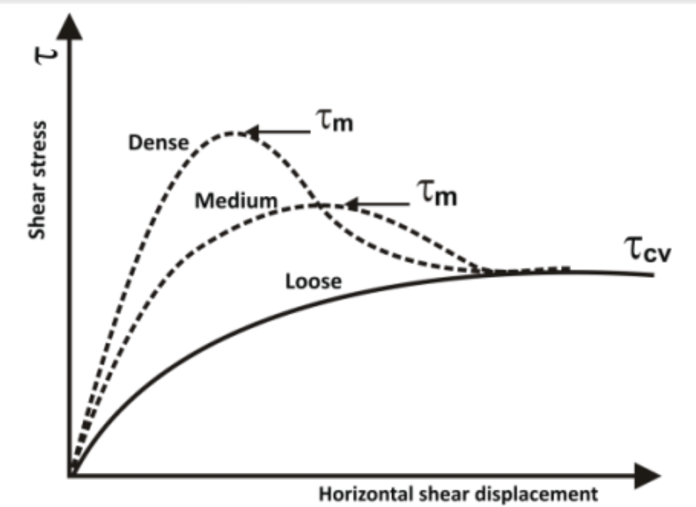
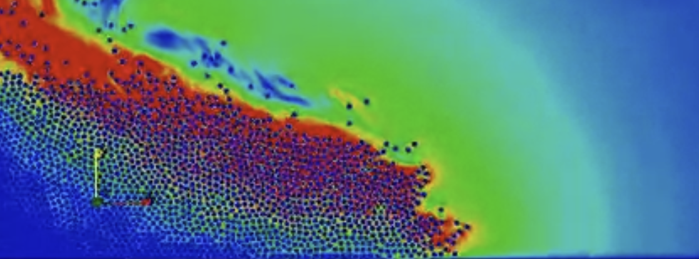
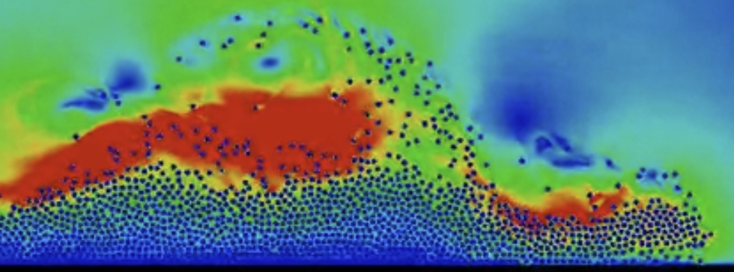
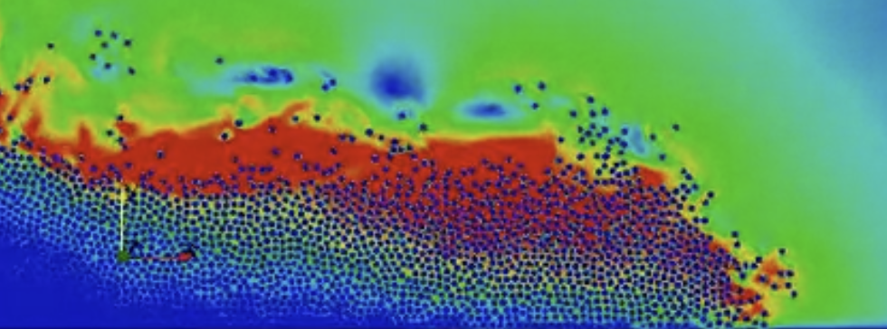
Limitations of ML
Magical NN
Input parameters
sigma = 100 kPa
dstrain = 1E-4
e0 = 1.2
Low-dim output
Training
Testing

Slide 3
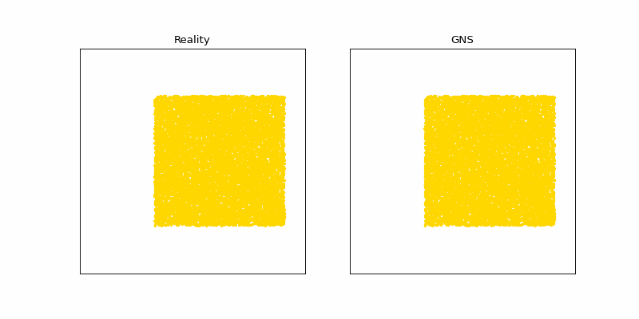
ML prediction of granular flows
MPM
GNS
1.5 hours runtime 5 s

Slide 4
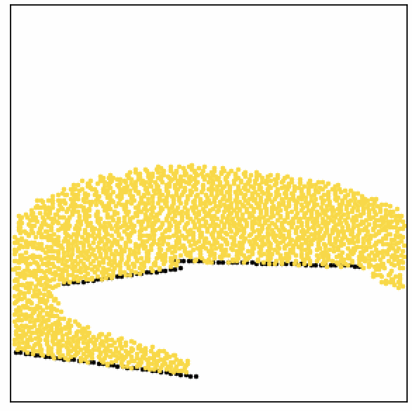
Inductive biases: Inertial Prior
Static prior
Inertial prior
Position: x(t) Velocity: v(t)

Slide 5
How does it work?
https://github.com/geoelements/gns

Slide 6
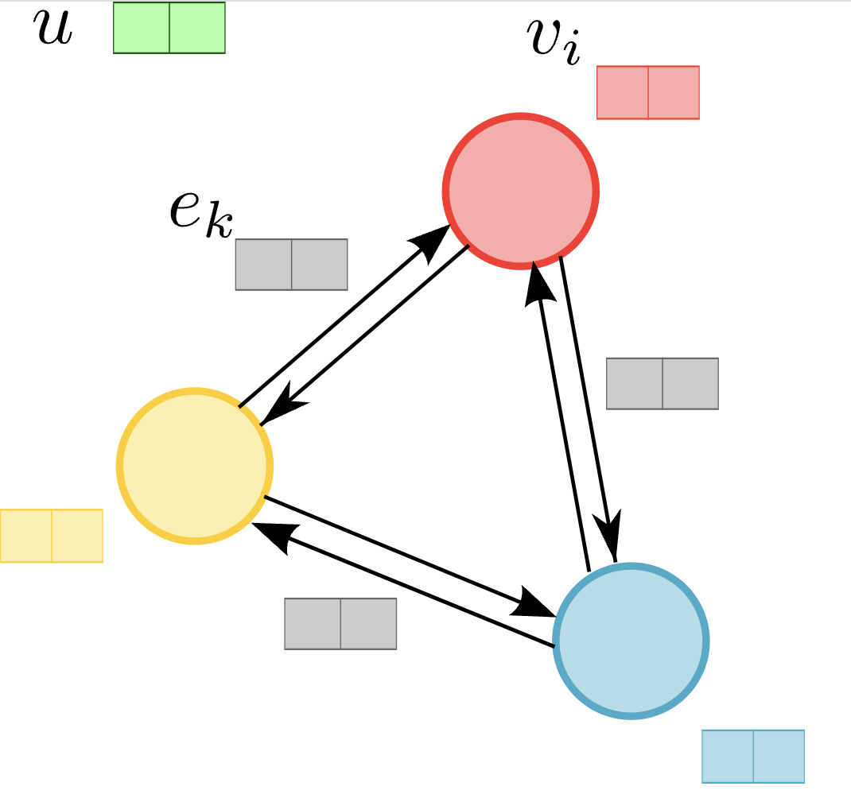
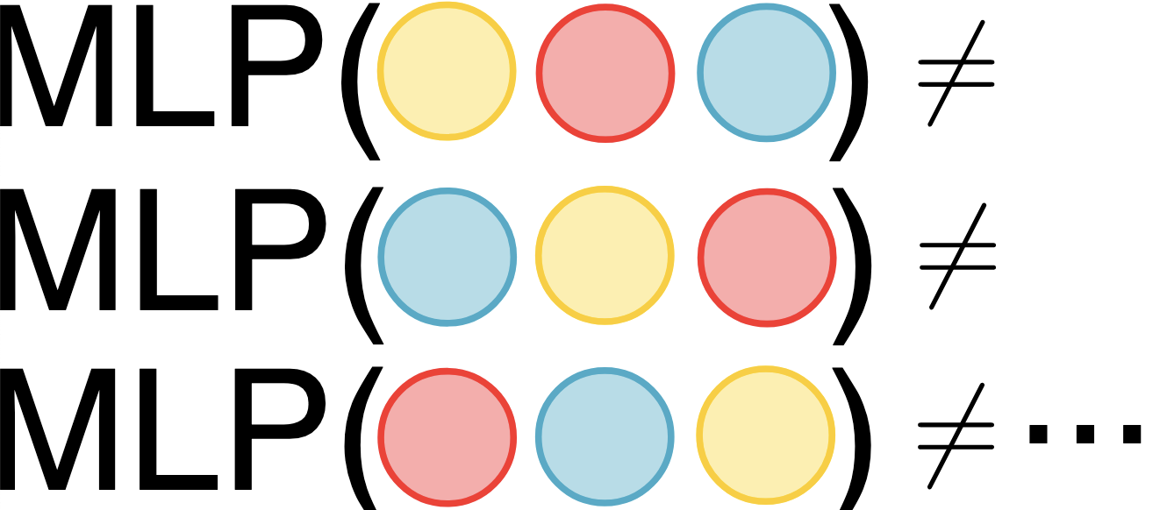
MLP vs GNN
MLPs operate over vectors
GNNs use message passing Permutation invariant

Slide 7
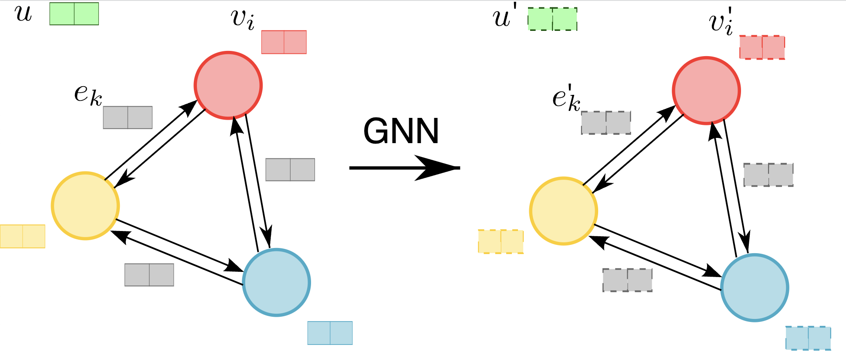
Graph Neural Networks
Update node features, edge features and global embedding

Slide 8
Graph Neural Networks: Edge update

Slide 9
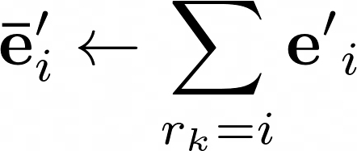
Graph Neural Networks: Node Update
Receiver edge aggregation (message pooling for every node)
Superposition principle

Slide 10
GNN Components

Slide 11
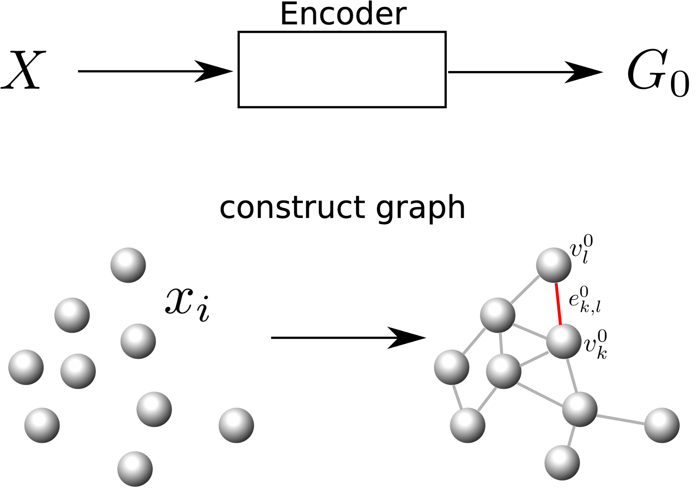
GNN: Encoder
Spatial equivariance
pos_{l,k} = pos_{l} - pos_{k}
pos_{k}; vel_{k}; type_{k}

Slide 12
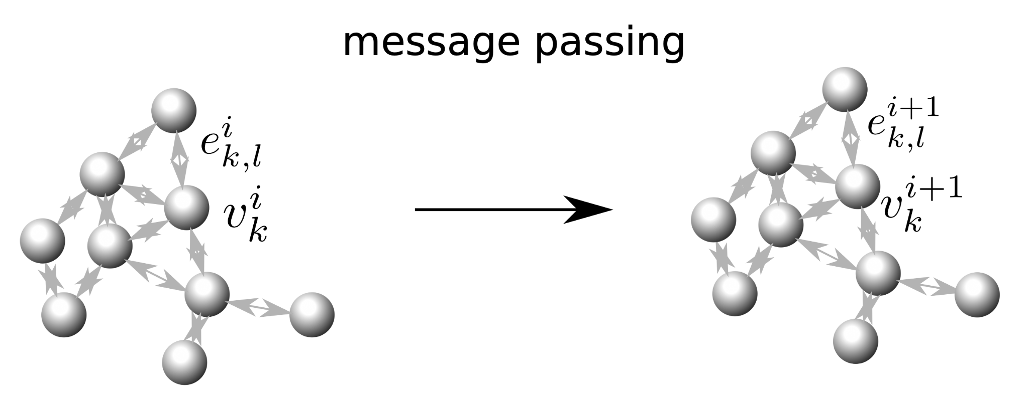
GNN: Message Passing

Slide 13
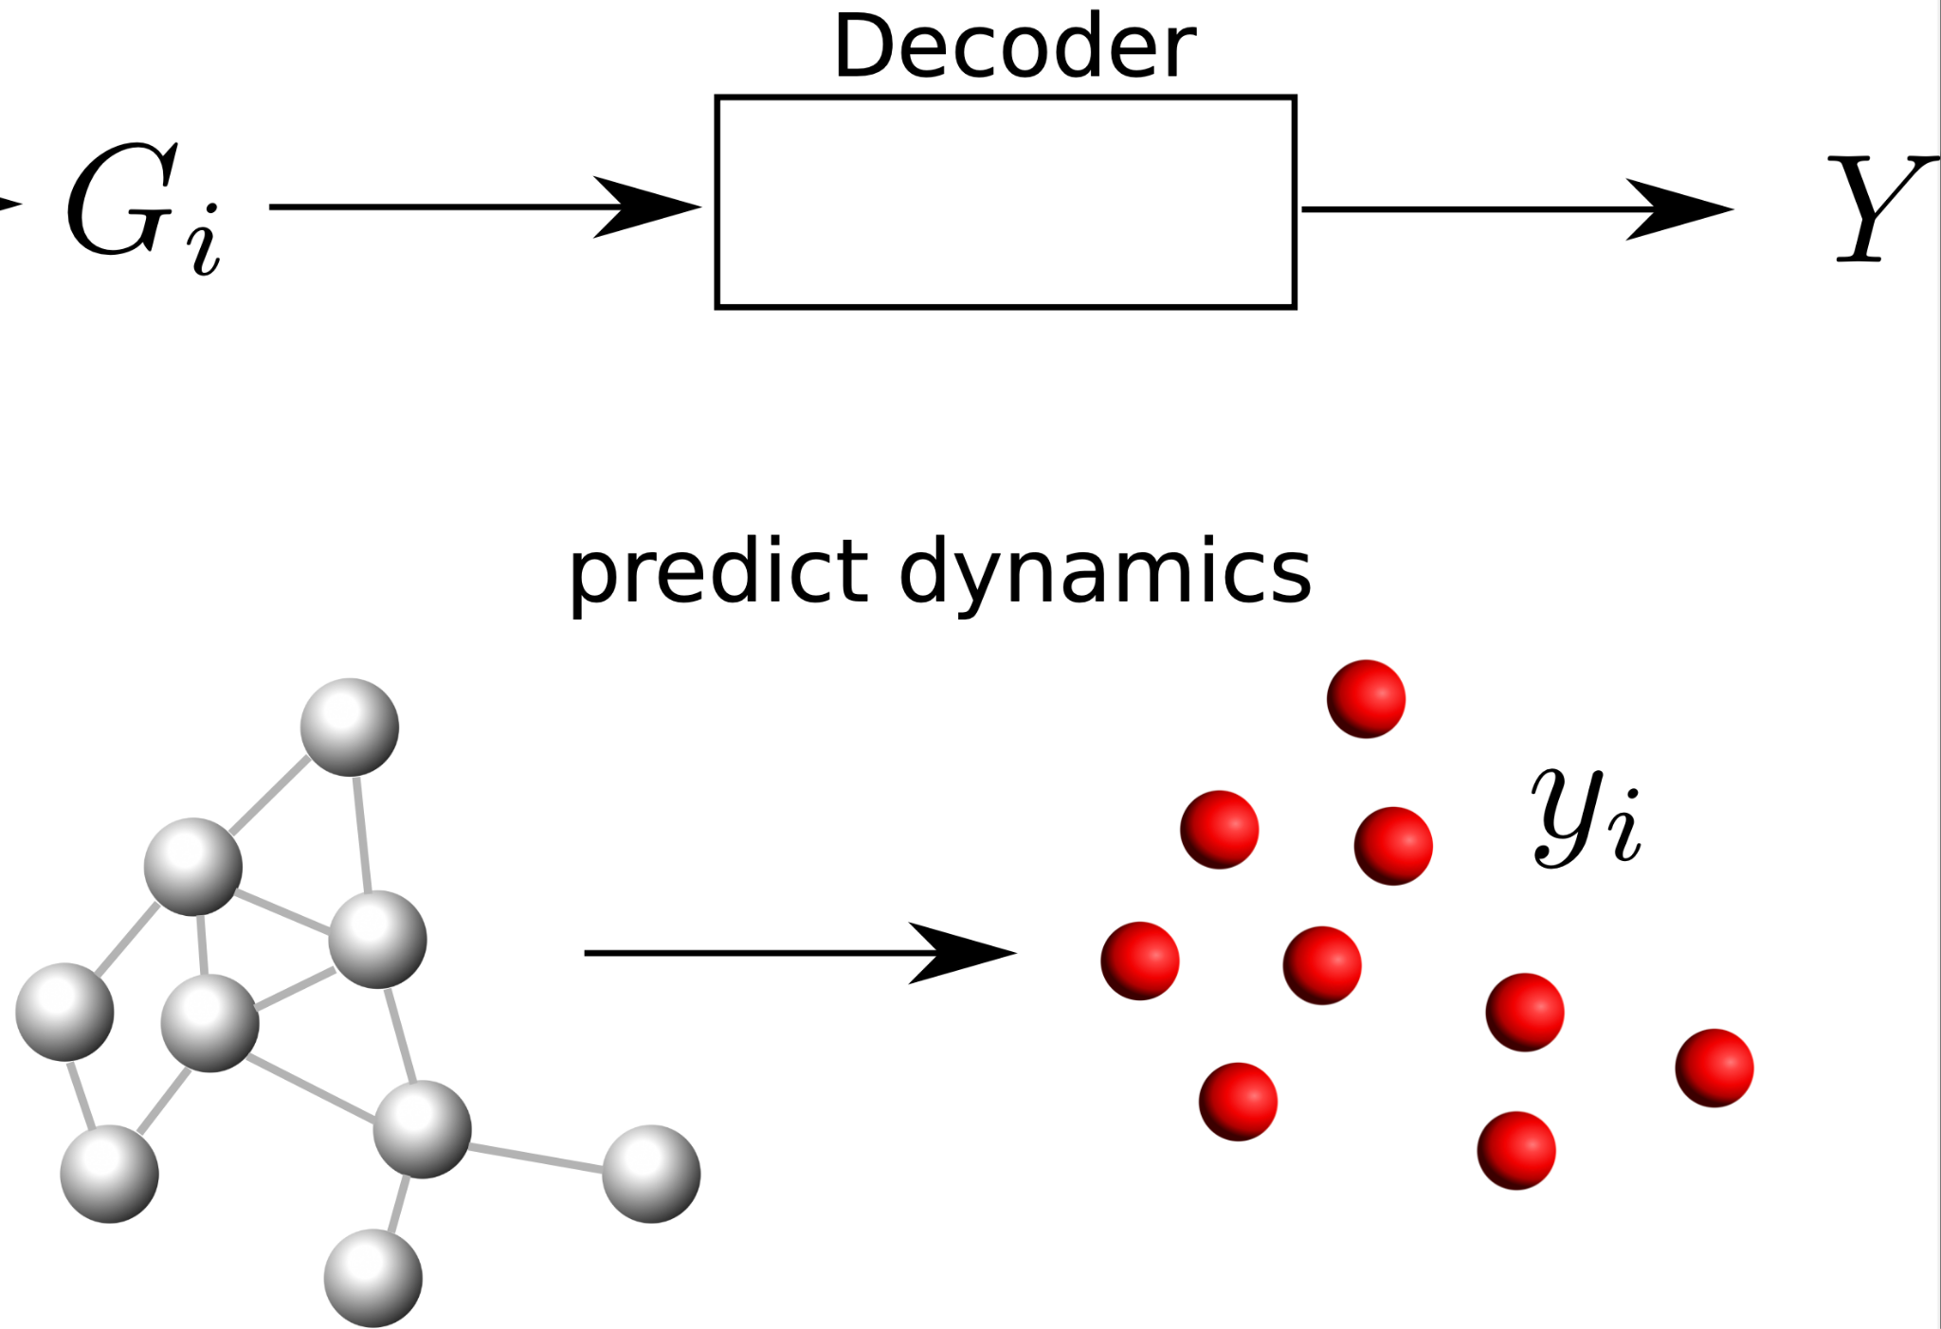
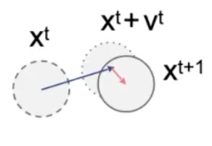
GNN: Decoder and Update
Predict acceleration:
v^{t+1} = v^{t} + decode(G)
x^{t+1} = x^{t} + v^{t+1}
We use: dt = 1

Slide 14
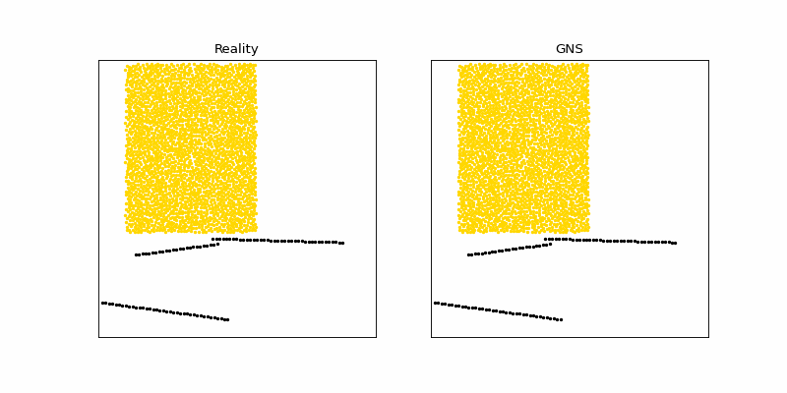
GNS prediction of granular flows with obstacles

Slide 15
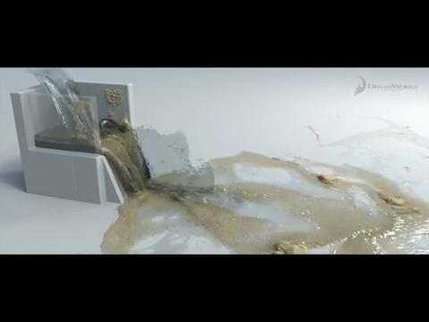
Ray-tracing for visualization
Dreamworks

Slide 16
In situ visualization
In situ viz

Slide 17
A machine learning oracle for in situ viz

Slide 18
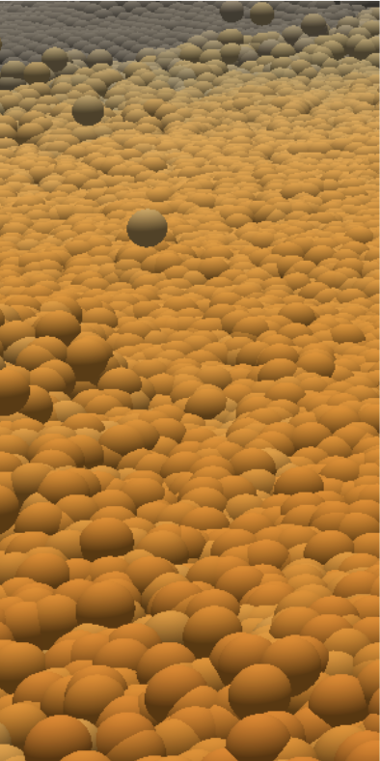
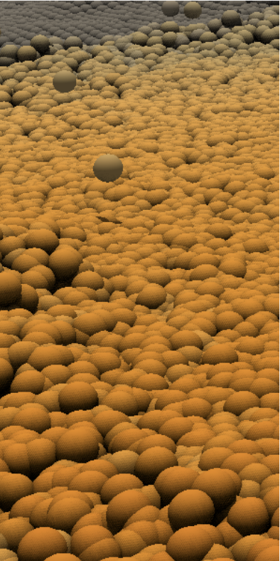
Rendering with Global Illumination
Notes:
50 million material points

Slide 19
TACC Galaxy and MPM Rendering of Oso Landslide (8 MPI Viz and 16 MPI Compute)
Notes:
50 million material points

Slide 20
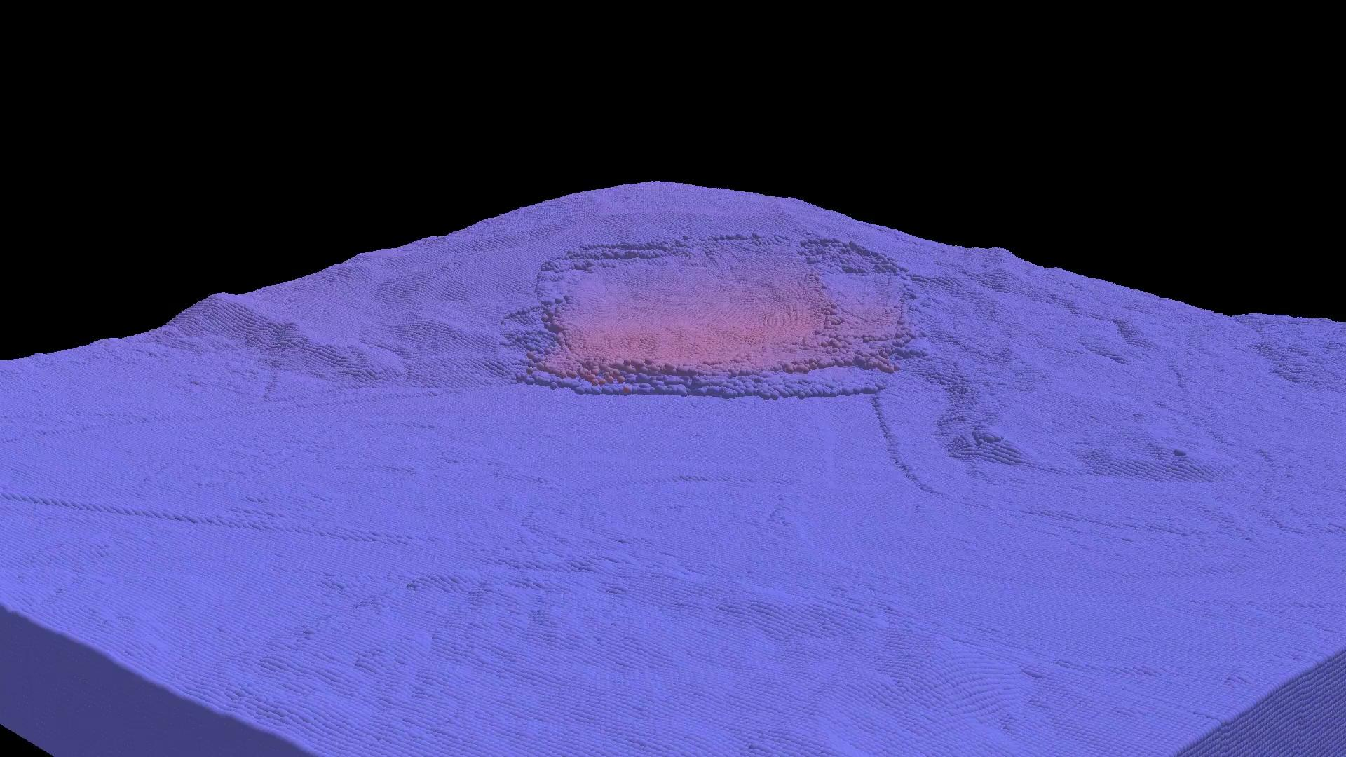
TACC Galaxy and MPM Rendering of Oso Landslide (8 MPI Viz and 16 MPI Compute)
Notes:
50 million material points

Slide 21
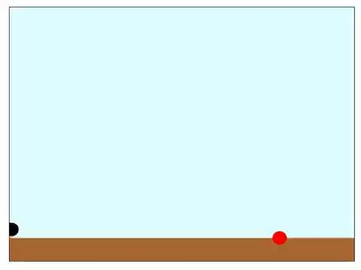
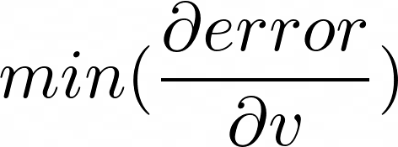
What’s an inverse problem?

Slide 22
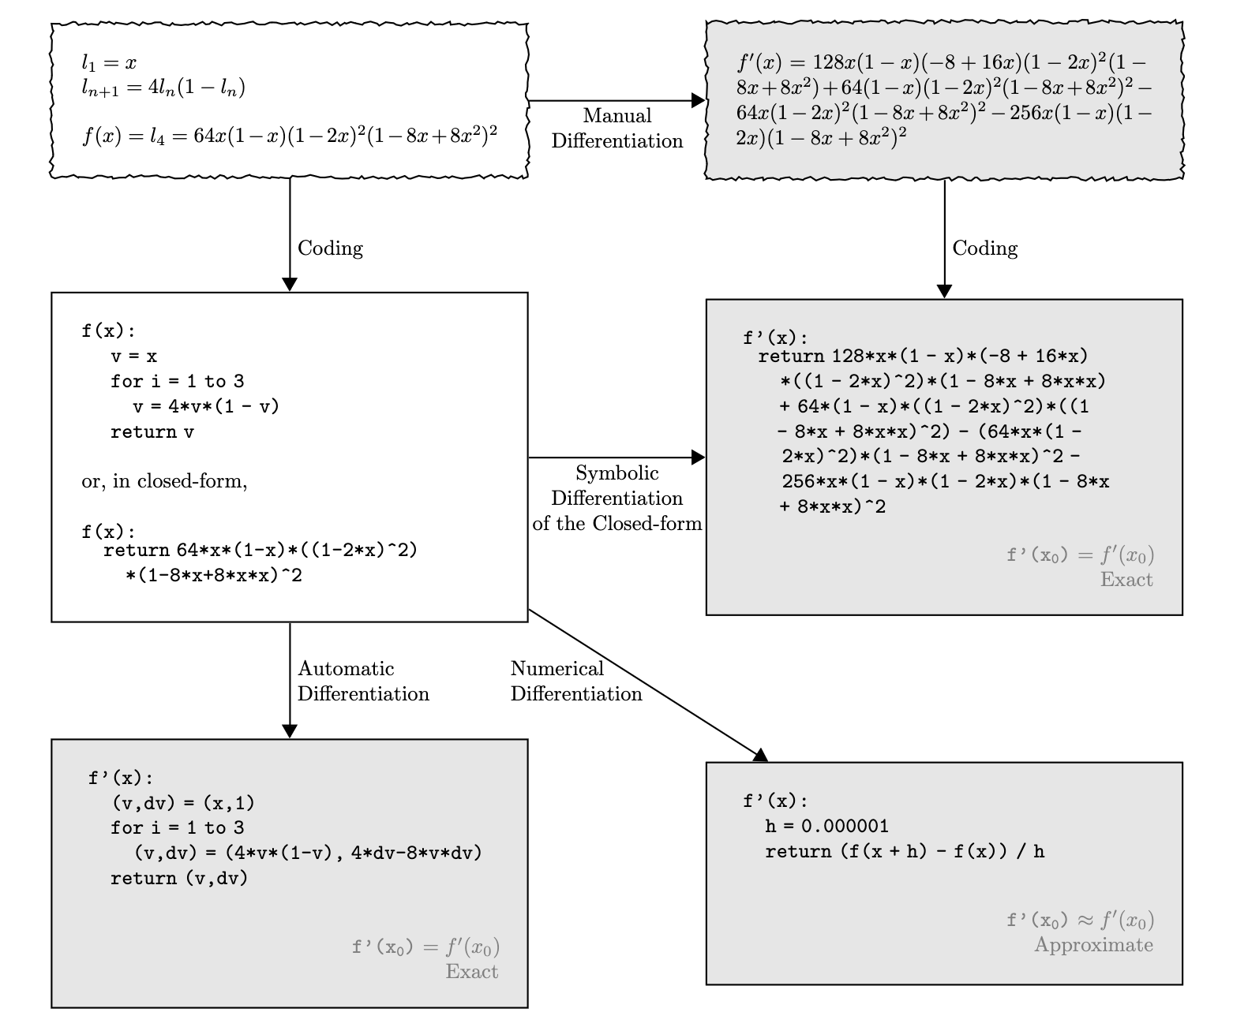
Methods of differentiation

Slide 23
What is automatic differentiation (AD)?
Notes:
Baydin et al., 2018
Emphasize that we use reverse-mode AD because we have an inverse problem

Slide 24
Break the function into elementary operations
Self-mult
Self-mult
Notes:
“redefines the semantics of operators” = break down into simpler operations

Slide 25
Assign names to nodes
Self-mult
Self-mult
Notes:
Replaces domain of variables = renaming nodes

Slide 26
Forward pass of values
Self-mult
Self-mult

Slide 27
Backward pass to compute partial derivatives
Self-mult
Self-mult

Slide 28
Use chain rule to calculate gradient
Self-mult
Self-mult
Notes:
Propagates derivatives using the chain rule

Slide 29
Use chain rule to calculate gradient
Self-mult
Self-mult

Slide 30
Use chain rule to calculate gradient
Self-mult
Self-mult

Slide 31
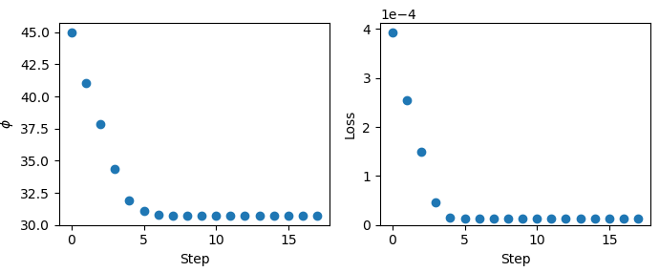
Inverse problem: Estimating the friction angle
Target (phi = 30 deg)
Initial phi guess (phi = 45 deg)
Final Gradient descent step (phi = 30.7 deg)

Slide 32
Differentiable Programming

Slide 33
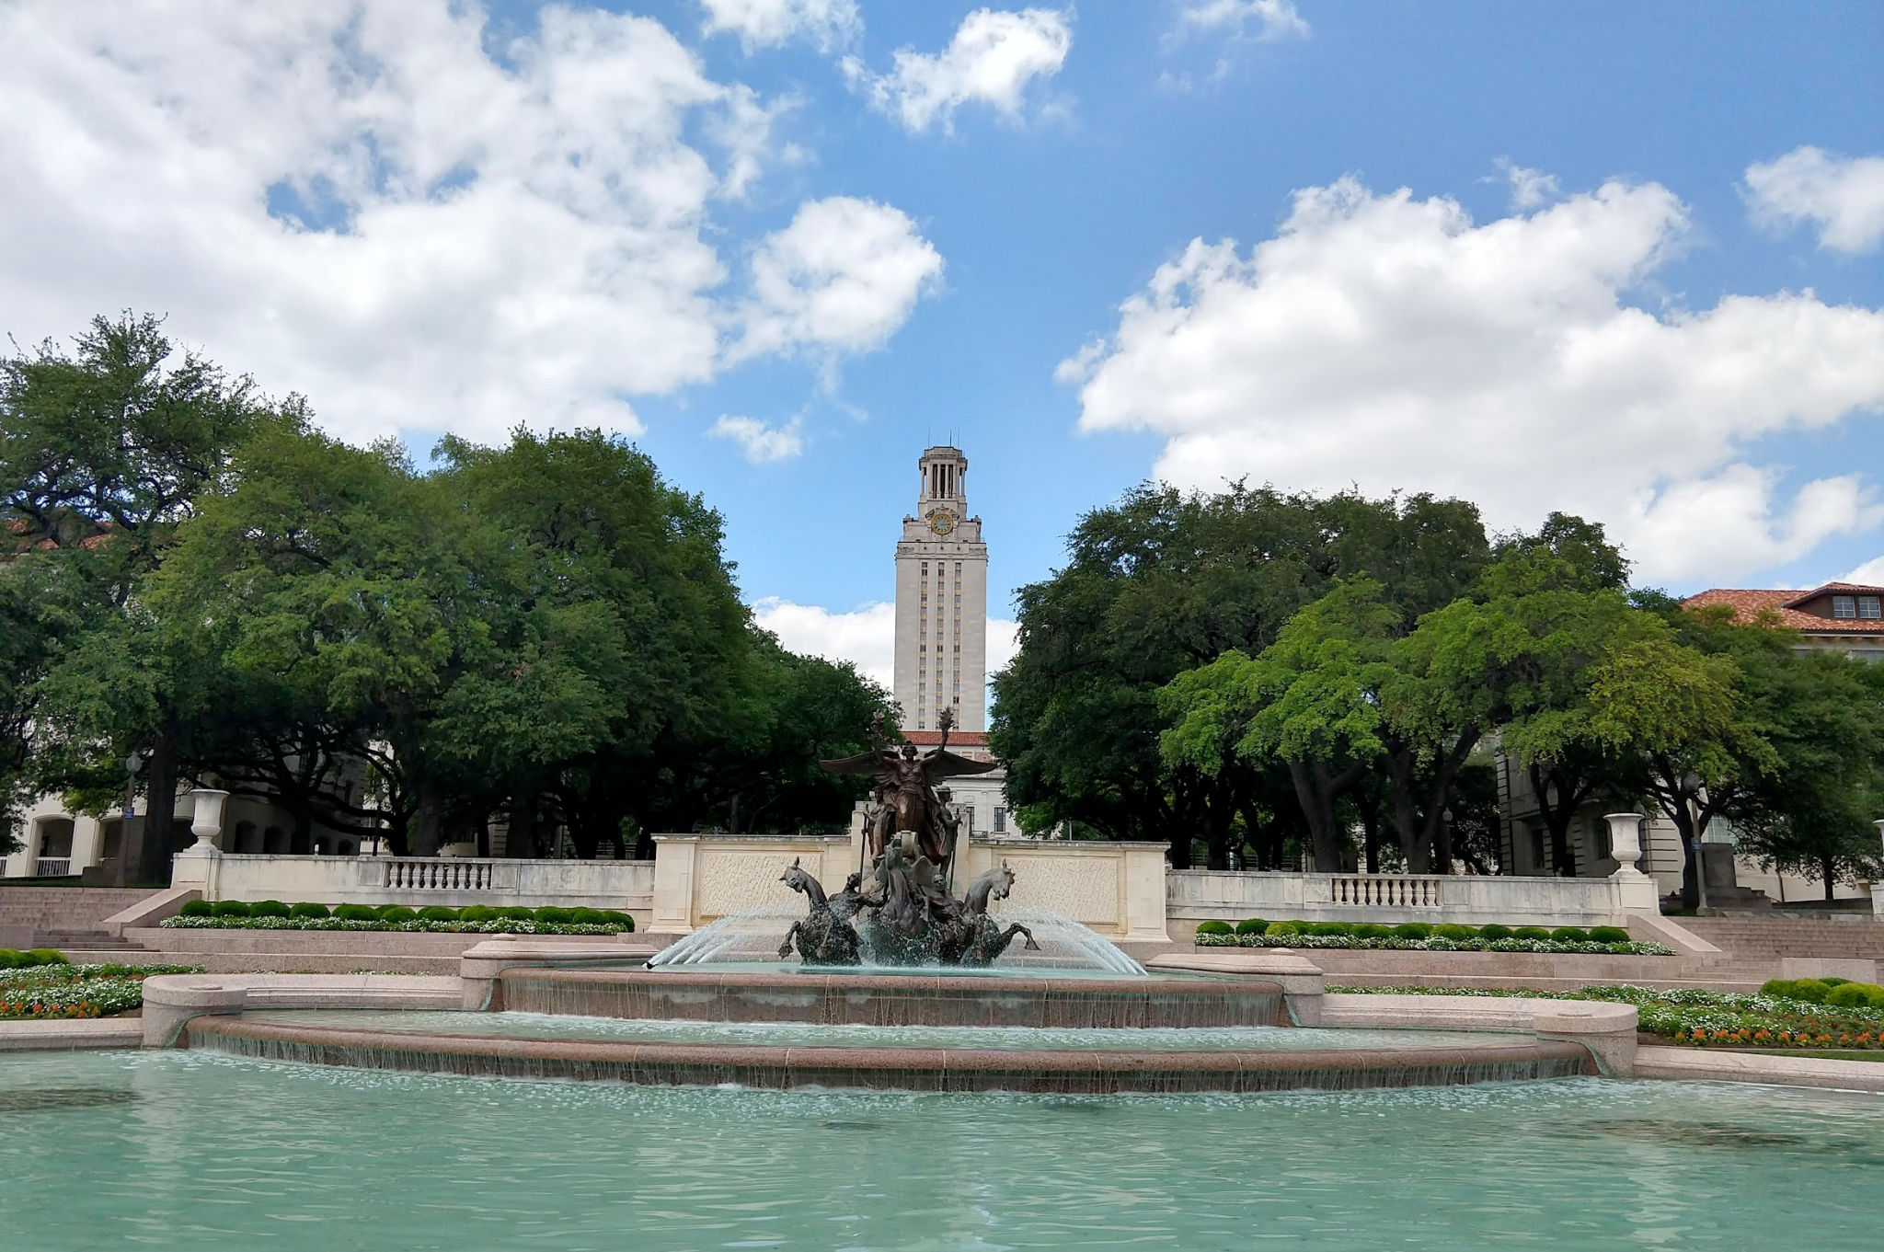
Hook ‘em Horns!
https://geoelements.org
This work was funded by NSF OAC: #2103937

